Slide 1
Flip-Flops. Counters. Registers.
The D Latch
The D Flip-Flop
Flip-Flop Symbols
A Basic Digital Counter (ripple counter)
A Synchronous Binary Counter
A Synchronous Decimal Counter
Serial to Parallel Shift register
Parallel to Serial Shift register
P&H Appendix-B
Wakerly Ch.7

Slide 2
The D Latch
Cannot experience a "race" condition caused by all inputs being at logic 1 simultaneously.

Slide 3
The D Flip-Flop

Slide 4
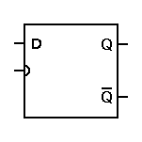
Flip-Flop Symbols

Slide 5
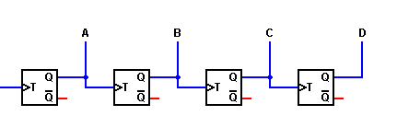
A Basic Digital Counter (ripple counter)

Slide 6
A Basic Digital Counter (ripple counter)

Slide 7
A Synchronous Binary Counter
States |  |  |  | Count
D | C | B | A
0 | 0 | 0 | 0 | 0
0 | 0 | 0 | 1 | 1
0 | 0 | 1 | 0 | 2
0 | 0 | 1 | 1 | 3
0 | 1 | 0 | 0 | 4
0 | 1 | 0 | 1 | 5
0 | 1 | 1 | 0 | 6
0 | 1 | 1 | 1 | 7
1 | 0 | 0 | 0 | 8
1 | 0 | 0 | 1 | 9
1 | 0 | 1 | 0 | 10
1 | 0 | 1 | 1 | 11
1 | 1 | 0 | 0 | 12
1 | 1 | 0 | 1 | 13
1 | 1 | 1 | 0 | 14
1 | 1 | 1 | 1 | 15

Slide 8
A Synchronous Decimal Counter
States |  |  |  | Count
D | C | B | A
0 | 0 | 0 | 0 | 0
0 | 0 | 0 | 1 | 1
0 | 0 | 1 | 0 | 2
0 | 0 | 1 | 1 | 3
0 | 1 | 0 | 0 | 4
0 | 1 | 0 | 1 | 5
0 | 1 | 1 | 0 | 6
0 | 1 | 1 | 1 | 7
1 | 0 | 0 | 0 | 8
1 | 0 | 0 | 1 | 9

Slide 9
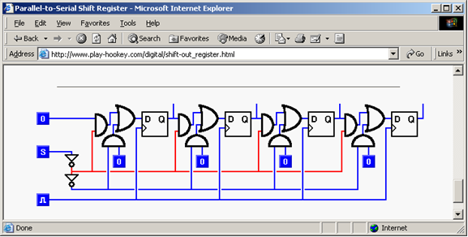
Serial to Parallel Shift register
Parallel to Serial Shift register

